Slide 1
Atomic Structure Discovery & History

Slide 2
Lesson Objectives
Describe and explain the contributions of each of the following scientists to the development of the atomic model: o Dalton, o Thomson, o Rutherford, o Bohr, o Chadwick Draw labelled diagrams and explain the structure of each of the atomic models associated with the scientists listed above. Draw and label a timeline showing the development of the atomic model. Explain how changes in technology have contributed to the atomic model and our understanding of the atom.

Slide 3
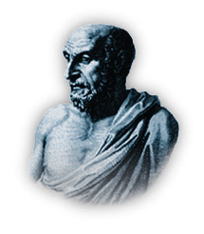
What is “atom”?
Atomos = indivisible
Atomism
The Greek philosopher Democritus (~460 B.C. – 370 B.C.)

Slide 4
These are iron atoms!!
Atomos = indivisible
Continuous division
Iron
Continuous division

Slide 5
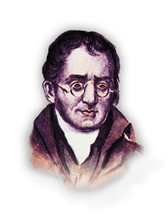
Dalton’s atomic theory
1803 AD John Dalton

Slide 6
Main points of Dalton’s atomic theory
1. All elements are made up of atoms.
Atoms cannot be created, divided into smaller particles, nor destroyed in the chemical process.
A chemical reaction simply changes the way atoms are grouped together.

Slide 7
Main points of Dalton’s atomic theory
3. Atoms of the same element are identical. They have the same mass and chemical properties.
4. Atoms of different elements are different. They have different masses and chemical properties.
5. When atoms of different elements combine to form a compound, they do so in a simple whole number ratio to each other.
Check Point 1-1

Slide 8
Steps to Thomson’s Atomic Model
1876 Goldstein
Discovery of cathode rays from discharge tube experiment.

Slide 9
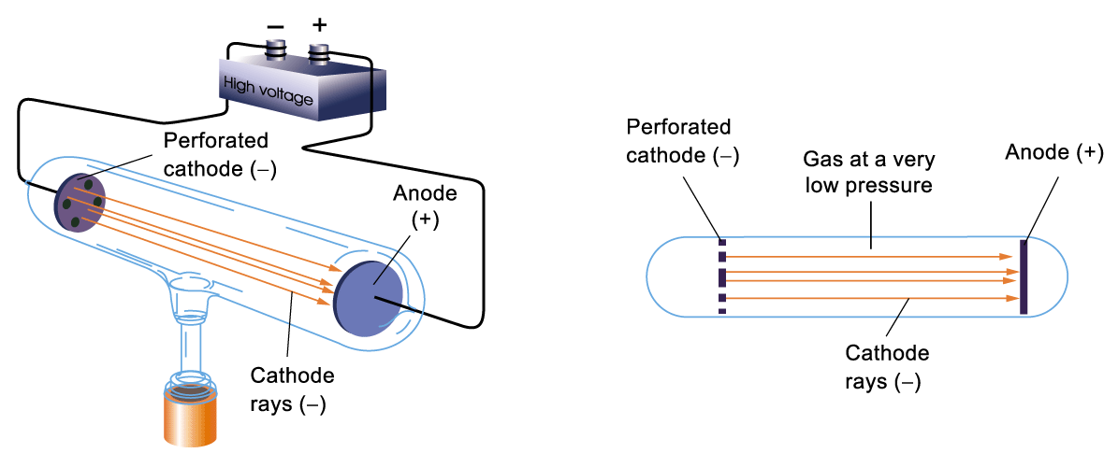
Discovery of Cathode Rays
A beam of rays came out from the cathode and hit the anode
Goldstein called the beam cathode rays

Slide 10
Demonstration of Cathode Rays (separate worksheet)
Magnetic field
Crooks tube (proof of electron mass)
CRT screens (early computers)

Slide 11
Steps to Thomson’s Atomic Model
1876 Goldstein
Discovery of cathode rays from discharge tube experiment.
1895 Crookes
Cathode rays are negatively charged particles which travelled in straight line. ⇒ electrons

Slide 12
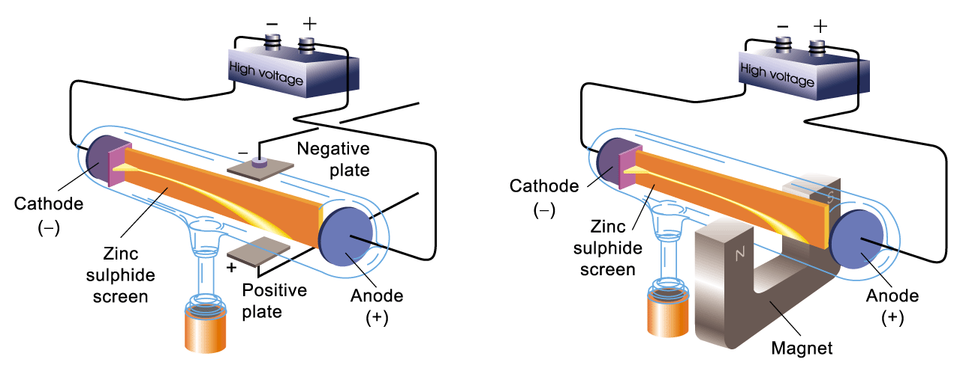
Deflected in the electric field
Deflected in the magnetic field

Slide 13
The beam was composed of negatively charged fast-moving particles.

Slide 14
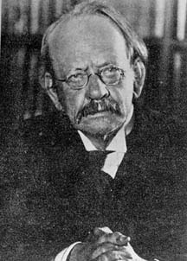
Measurement of the m/e ratio of ‘electron’
1897
J J Thomson (1856-1940)

Slide 15
Measure the mass to charge ratio (m/e) of the particles produced
Independent of the nature of the gas inside the discharge tube
The particles were constituents of all atoms!!
Thomson called the particles ‘electrons’.

Slide 16
Thomson’s atomic model
An atom was a positively charged sphere of low density
The positively charged sphere is balanced electrically by negatively charged electrons
Atom
Electron

Slide 17
How are the particles distributed in an atom?
Most of the mass of the atom was carried by the electrons (>1000 e⁻)
An atom was a positively charged sphere of low density with negatively charged electrons embedded in it like a plum pudding
Positive charge
Electron

Slide 18
How are the particles distributed in an atom?
Like a raisin bun
Positive charge
Electron

Slide 19
How are the particles distributed in an atom?
Experimental evidence : -
Powerful projectiles such as α-particles passes straight through a thin gold foil.
Analogy : -
α-particle vs a thin gold foil
≡ 15-inch canon ball vs a piece of paper

Slide 20
Lesson Objectives
Describe and explain the contributions of each of the following scientists to the development of the atomic model: Dalton Thomson, o Rutherford, o Bohr o Chadwick Draw labelled diagrams and explain the structure of each of the atomic models associated with the scientists listed above. Draw and label a timeline showing the development of the atomic model. Explain how changes in technology have contributed to the atomic model and our understanding of the atom.

Slide 21
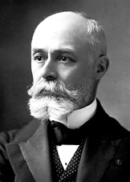
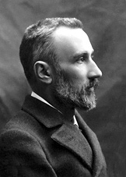
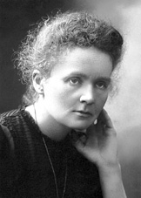
Steps to Rutherford’s Atomic Model
Nobel laureates, Physics, 1903
Becquerel
Pierre Curie
Marie Curie

Slide 22
Steps to Rutherford’s Atomic Model
1896 Becquerel
1st discovery of radioactive substance.
(an uranium salt)

Slide 23
Steps to Rutherford’s Atomic Model
1898 Pierre & Marie Curie
Radioactive polonium and radium were isolated
1g from 500 Kg pitchblende

Slide 24
The Curie Family
Pierre & Marie Curie
Nobel laureate, Physics, 1903
Marie Curie
Nobel laureate, Chemistry, 1911
Federic Joliet & Irene Joliet-Curie
Nobel laureate, Chemistry, 1935

Slide 25
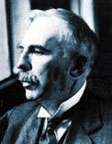
Steps to Rutherford’s Atomic Model
1899 Rutherford
(Nobel laureate, Physics, 1908)
Discovery of α and β radiations.
α radiation → He²⁺
β radiation → e⁻

Slide 26
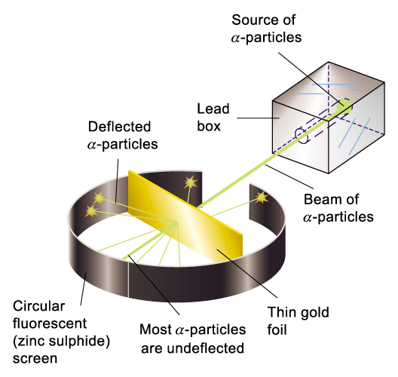
A thin gold foil was bombarded with a beam of fast-moving α-particles (+ve charged)
Observation:
most α-particles passed through the foil without deflection
very few α-particles were scattered or rebounded back

Slide 27
It was quite the most incredible event that has ever happened to me in my life.
It was almost as incredible as if you fired a 15-inch shell at a piece of tissue paper and it came back and hit you.

Slide 28
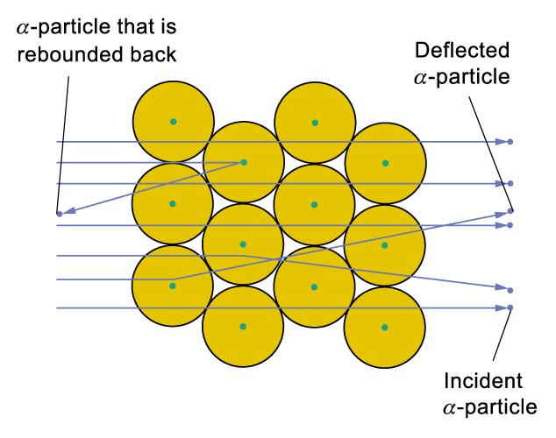
Interpretation of the experimental results
Nucleus is positively charged because it repels the positively charged alpha particles.

Slide 29
Interpretation of the experimental results
Nucleus occupies a very small space (10⁻¹² of size of atom) because very few α particles are deflected.

Slide 30
Interpretation of the experimental results
The radius of an atom is about 20,000 times that of the nucleus. Thus, if we imagine a large football stadium as being the whole atom, then the nucleus would be about the size of a peanut.

Slide 31
Interpretation of the experimental results
Nucleus is relatively massive and highly charged because of the large deflection.

Slide 32
Interpretation of the experimental results
Number of positive charges in each nucleus can be calculated from experimental results
⇒ Presence of protons in nucleus

Slide 33
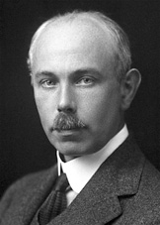
Steps to Chadwick’s Atomic Model
1919 F. W. Aston
(Nobel laureate, Chemistry, 1922)
Isotopes of Neon were discovered using mass spectrometry

Slide 34
Steps to Chadwick’s Atomic Model
1920 Rutherford
Postulated the presence of neutrons in the nucleus

Slide 35
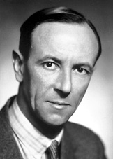
Steps to Chadwick’s Atomic Model
James Chadwick
(Nobel laureate, Physics, 1935)
Discovery of the neutron

Slide 36
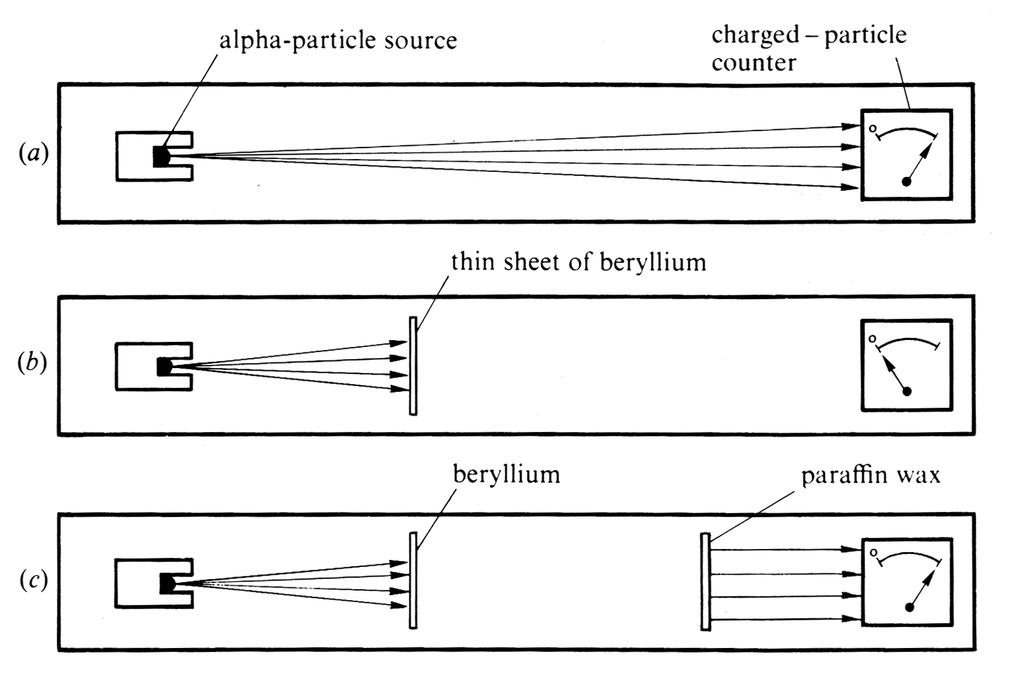
Chadwick’s Experiments

Slide 37
Steps to Chadwick’s Atomic Model
Interpretation : -
+
+

Slide 38
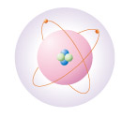
Chadwick’s atomic model
Proton
Electron
Neutron

Slide 39
Lesson Objectives
Describe and explain the contributions of each of the following scientists to the development of the atomic model: Dalton Thomson, Rutherford, o Bohr Chadwick Draw labelled diagrams and explain the structure of each of the atomic models associated with the scientists listed above. Draw and label a timeline showing the development of the atomic model. Explain how changes in technology have contributed to the atomic model and our understanding of the atom.

Slide 40
Activity
Create a timeline demonstrating the
development of the atomic model.
You must include:
A drawing of the atomic model at each stage of development
The technology found at each stage
Neils Bohr is another contributor to the atomic model.
Research him and include this in your model.

Slide 41
Lesson Objectives
Describe and explain the contributions of each of the following scientists to the development of the atomic model: Dalton Thomson, Rutherford, o Bohr Chadwick Draw labelled diagrams and explain the structure of each of the atomic models associated with the scientists listed above. Draw and label a timeline showing the development of the atomic model. Explain how changes in technology have contributed to the atomic model and our understanding of the atom.

Slide 42
Neils Bohr’s Flame Test
The following practical commemorates Neils Bohr in all his glory.
We will test a number of salts that will allow us to see the spectra that Neils Bohr did his work with on Energy Levels.
Terms you ought to look out for are:
Emission spectra
Energy Levels
Electron

